Slide 1


CollisionX India
Indian Traffic Violation Detection
Internship Program: Infosys Springboard
Duration: 8 weeks | Track: Python

Slide 2


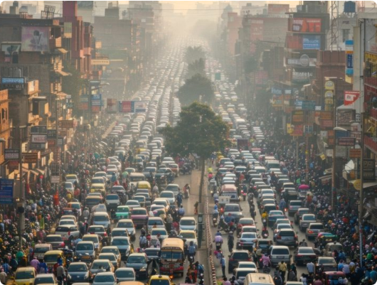
Introduction
India is witnessing a rapid rise in traffic violations, posing significant challenges to urban management.
•
Urbanization Impact: Rapid urban growth has drastically increased vehicle density.
•
Rising Frequency: Higher density leads to frequent and varied traffic violations.
•
Current Limitations: Traditional monitoring methods are largely manual, reactive, and resource-intensive.

Slide 3
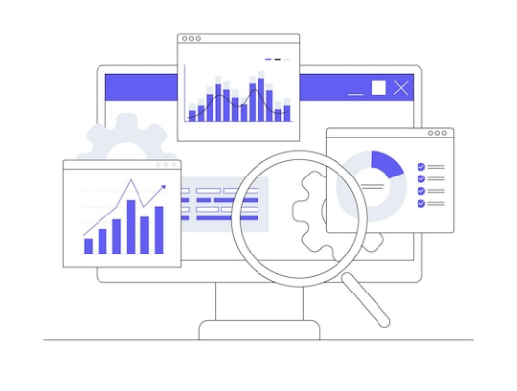

Problem Statement
Manual monitoring is slow, inconsistent, and lacks real-time insights, contributing to accidents and congestion.
Core Issues
Manual monitoring is slow & inconsistent.
Lack of quick, actionable data insights.
Critical need for an automated analytical system.

Slide 4






Objectives
Our primary goals for the CollisionX project are focused on data-driven solutions.
Analyze Data
Interactive App
Visualize Insights
To rigorously analyze traffic violation data to identify underlying causes and trends.
To create an interactive Streamlit web application for real-time monitoring.
To visualize complex patterns and provide clear, actionable insights for authorities.

Slide 5
Dataset Information
Key Features
4,000
•
Violation Details: Type, Fine Amount, Date/Time.
•
Driver Info: Demographics, License Type.
TOTAL RECORDS
•
Vehicle Data: Vehicle Type, Make, Model.
33
•
Road Conditions: Surface Type, Traffic Density.
•
Weather Factors: Visibility, Precipitation.
FEATURES EXTRACTED
•
Speed & Limits: Recorded Speed vs. Limit.

Slide 6






Tech Stack
Language
Tools
Framework
Libraries
Python
Jupyter, VS Code, GitHub
Streamlit
Pandas, NumPy, Matplotlib

Slide 7





Libraries & Frameworks
Streamlit
Turns data scripts into shareable web apps in minutes. Essential for our dashboard UI.
Pandas & NumPy
High-performance data manipulation, analysis, and numerical computing.
Matplotlib & Seaborn
Comprehensive libraries for creating static, animated, and interactive visualizations.

Slide 8
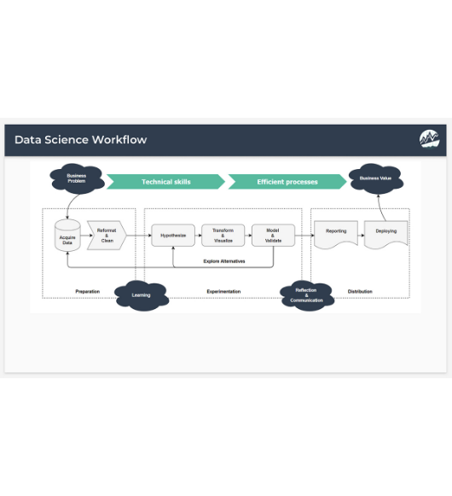





Workflow Diagram
Our systematic approach ensures raw data is transformed into meaningful insights efficiently.

Slide 9




Feature Extraction
We categorized the 33 extracted features into four key domains for analysis.
Violation Specifics
Driver & Vehicle
Type of violation, Fine amount, Payment status, Safety compliance.
Driver demographics, Vehicle make/model, Registration type.
Environmental
Spatio-Temporal
Weather conditions, Road surface state, Light conditions.
Geolocation (Lat/Long), Time of day, Day of week, High-risk zones.

Slide 10
Results & Insights
Key Findings
•
High-Risk Zones: Identified specific intersections with 40% higher violation rates.
•
Violation Patterns: Peak violations occur during evening rush hours (5 PM - 8 PM).
•
Common Types: Speeding and Signal Jumping account for 60% of all cases.
•
Vehicle Trends: Two-wheelers are the most frequent violators in urban zones.

Slide 11


Conclusion & Future Scope
Conclusion
Future Scope
The project effectively analyzes traffic violation data to identify critical patterns.
•
Machine Learning: Implementing predictive models for violation forecasting.
It demonstrates the power of data-driven decision making in urban traffic monitoring.
•
IoT Integration: Connecting with Smart Cameras for automated real-time tagging.
Highlights key trends such as peak violation times and high-risk vehicle categories.
•
Policy Recs: Generating automated reports for traffic policy adjustments.

Slide 12

Demo Time
Live walkthrough of the Streamlit Application

Slide 13


THANK YOU
We are open to questions.

Slide 14






Image Sources
https://indian-drivers.com/wp-content/uploads/2025/04/Drimo-Blog-Images-9-1-1024x538.jpg
Source: indian-drivers.com
https://img.freepik.com/premium-vector/business-data-analytics-design-concept-finance-investment-monitor-report-dashboard-abstract-vector_773844-490.jpg
Source: www.freepik.com
https://miro.medium.com/0*5gKVOiLJN-kKgJcx.png
Source: medium.com
https://www.business-science.io/assets/2019-06-27-data-science-workflow/the-data-science-workflow.jpeg
Source: www.business-science.io
https://i.ytimg.com/vi/QeJLStiZubo/hq720.jpg?sqp=-oaymwEhCK4FEIIDSFryq4qpAxMIARUAAAAAGAElAADIQj0AgKJD&rs=AOn4CLCsfUUF9g3HrtO95Vk0QpvbAs__1g
Source: www.youtube.com
https://slidemodel.com/wp-content/uploads/FF0137-01-contact-us-slide-16x9-2.jpg
Source: slidemodel.com

